Slide 1
Welcome to Business & Marketing & Economics
Mrs. Ryfka Schafer

Slide 2
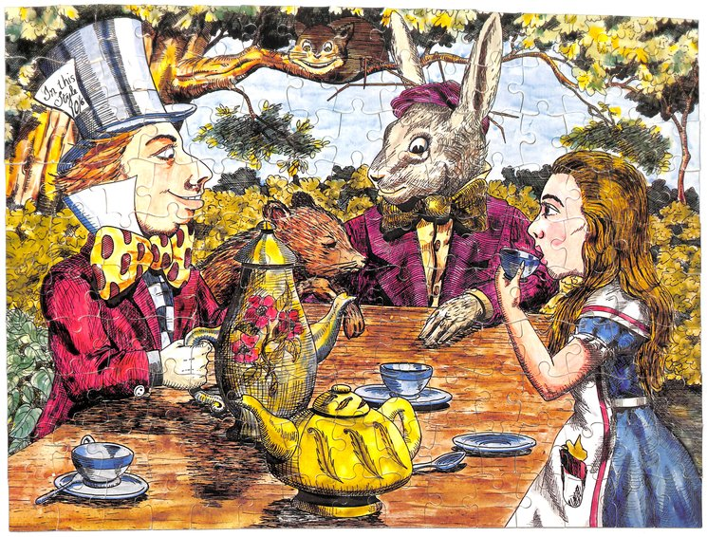
Mad Tea Party
Form two concentric circle, with each student facing one other student.
Begin by greeting each other by name and giving an elbow bump.
Mrs. Schafer reads one question and each pair has 1 minute to share their answers with each other
Mrs. Schafer signals the end of conversation and asks students to thank their partner
Outer circle spins one partner to the left. (Inner circle stays fixed)
Students greet their new partner
Repeat with a new question.

Slide 3
Questions
What is one thing you did during summer break?
Where is one place you went during summer break?
Who is one person you saw during summer break that meant something special to you?
What is one thing you watched on a screen during break?
What are you looking forward to doing in this class?
What is society’s biggest challenge in this day and age?
What is something businesses could do to help fix this challenge?
If you made money during break, how did you do it? Job? Internship?
Which class are you most looking forward to being in this year, besides business of course?
Dream Big! If you could have one superpower what would it be and why?

Slide 4

Why do you think we just had the mad hatter tea party?
You’ll be working closely with each other this year/need to know who each other are
Group projects with different people each time
Networking, keeping these contacts potentially for the rest of your life
You’re all going places--best way to get a job is through who you know

Slide 5
Attendance & Name Preferences & Pronouns
Class Admin
Sandwich Making
Dual Credit
Instructor Introduction
Syllabus & Grades
Expectations
Digital Reputation

Slide 6
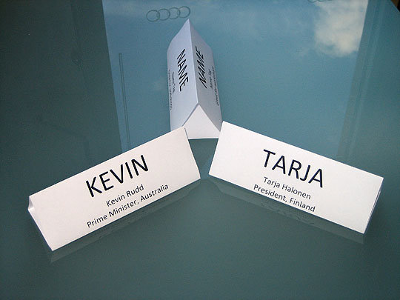
WELCOME TO BUSINESS CLASS!
Please take a piece of paper, fold it in half, and write your name on it in marker.
Write or draw pictures of three things that you like next to your name
You need to use each other’s names when calling on each other in class. We’ll use these for semester 1 and guest speakers.

Slide 7
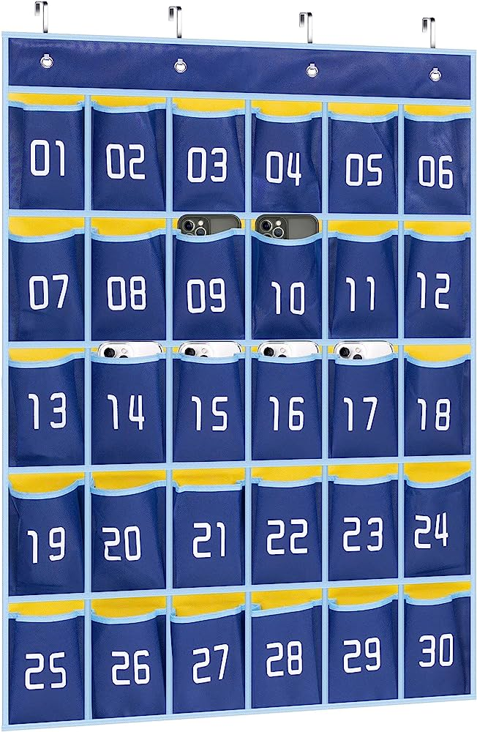
When you get into class each day…
Grab your name tag and put it on your desk (put it away at the end of the period/leave it in this classroom)
Put your cell phone in the pockets
I’ll sometimes take attendance via the phone chart, sometimes call out names, sometimes use the seating chart

Slide 8

Names
What do you want to be called
How to pronounce your name
(Optional) she/he/they pronoun if you want to tell us

Slide 9
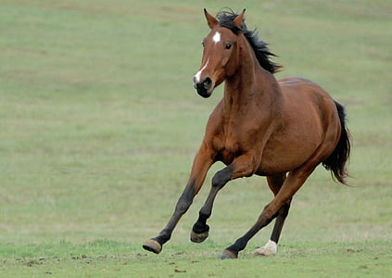
Riddle
You are on a Horse that is running at a high speed.
To the right of you is a steep drop-off.
In front of you is a Kangaroo that is also running at a very high speed.
To the left of you is a very large, glaring Elephant that is jogging--but seems to be keeping up with you.
Behind you is a roaring Lion that may or may not be catching up to you.
How do you get out of this dire situation?
Write your answer on a post-it note. Sign your name.
Notes:
Answer: Step off the carousel
1. different people think different things even when given the same scenario
So much of business is about creativity and thinking out of the box.
3. There isn't always one right answer in business

Slide 10
What does this riddle showcase?
Different people think different things, even when given the same scenario
So much of business is about creativity and thinking out of the box.
There isn't always one right answer in business
Notes:
Answer: Step off the carousel
1. different people think different things even when given the same scenario
So much of business is about creativity and thinking out of the box.
3. There isn't always one right answer in business

Slide 11
Class Admin
Cell phones in phone chart, other electronic rules (laptops, headphones away)
Name tags for semester 1
Treat like a college class as much as I can, taking a lot of ideas from graduate school classes
Use of laptops sometimes, so bring them charged and ready to use
Can use written notebook to take notes/not electronic, can use your handwritten notes on all exams
Exams are different in this class
Restroom requests
Student/teacher communication
Students advocating for themselves
Office hours after school Mon-Thurs and by appointment (real-world style)

Slide 12
Using Canvas This Year
Let’s look at it together
Where will you find my powerpoints
Assignments
Announcements
Office Hours/Contact me
Syllabus

Slide 13
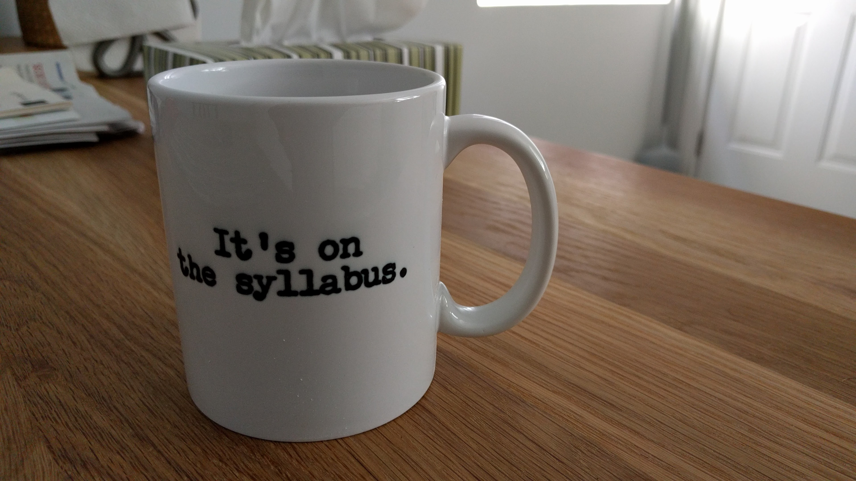
Syllabus & Grading
Assignment and grade breakdown for the year
Unlimited extra credit on participation grade each quarter

Slide 14
How Extra Credit Works In This Class
Unlimited on the quarterly participation grade
Can negotiate with me for what extra thing(s) you want to do and for how many points

Slide 15
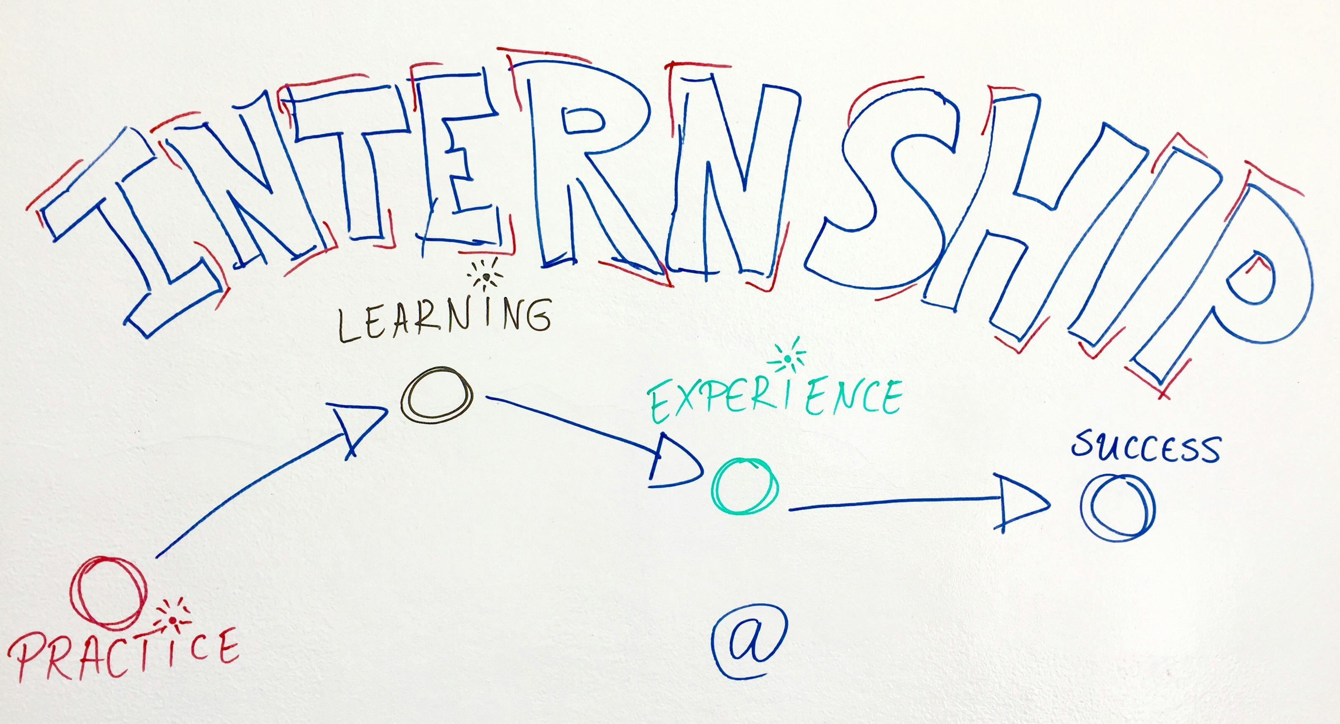
Internship
All business students will do an internship during Q1, mostly during class time
SWOT analysis on a small business or non-profit
You can write this on your resume
You can use the experience for college essays/interviews

Slide 16
EEO Violations
Equal Employment Opportunity
EEO laws prohibit discrimination against a job applicant or employee based on their race, color, religion, sex, sexual orientation, age, national origin, and physical or mental disability in all aspects of employment, including promotion, training, and other personnel actions.
How to get a 0 on your group project: discriminate against a group member based on any of the aforementioned protected classes
Real life examples from our school:
not listening to a female student’s ideas because “girls aren’t as smart”
Group projects are all about collaboration and being able to find each person’s individual strengths and figuring out how best to utilize that for the success of the group (maybe someone isn’t great with numbers, but they’re the artist in the group who can make the slides look professional. Or maybe someone isn’t great with keeping the team on track, but they’re the best at public speaking. Or maybe someone isn’t great at research but they’re the best at finding a business contact—all of these skills are crucial to the team’s success!)

Slide 17
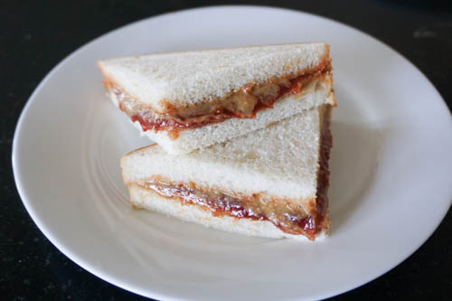

Slide 18
Sandwich Making
Assignment of team
On a piece of paper, write:
All names (first and last) of people in your group
Catchy name of this sandwich
3 sentence or less description of the sandwich that makes it sound good
Instructions on how to make this sandwich using the materials you know are available
Sandwich that looks the best at the end-whole team wins a pick through the “bag of good or bad”
Worth 40 pts in gradebook (you’ll have about 500 pts the first quarter)

Slide 19
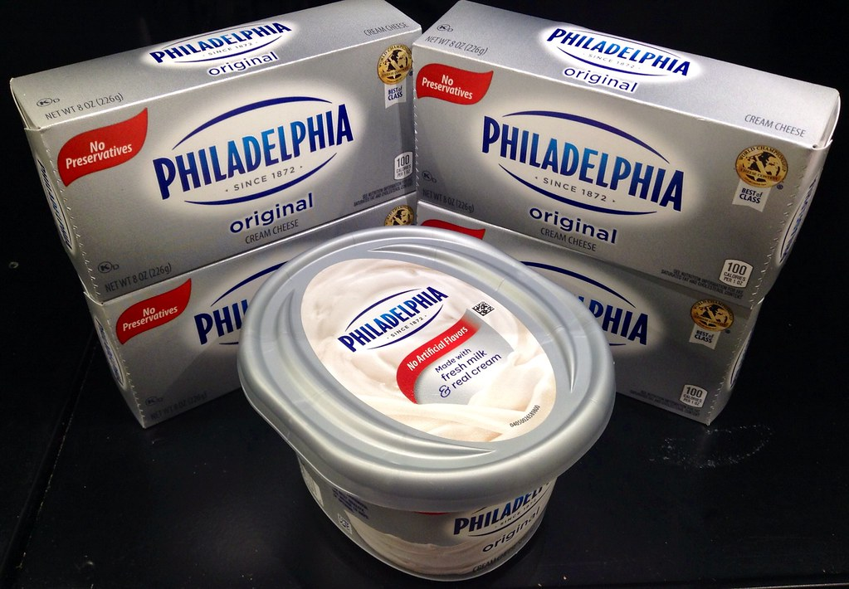
What you’ll have for the sandwiches
Bread
Cream cheese
Jelly
Spoon
Knife
This Photo by Unknown Author is licensed under CC BY

Slide 20
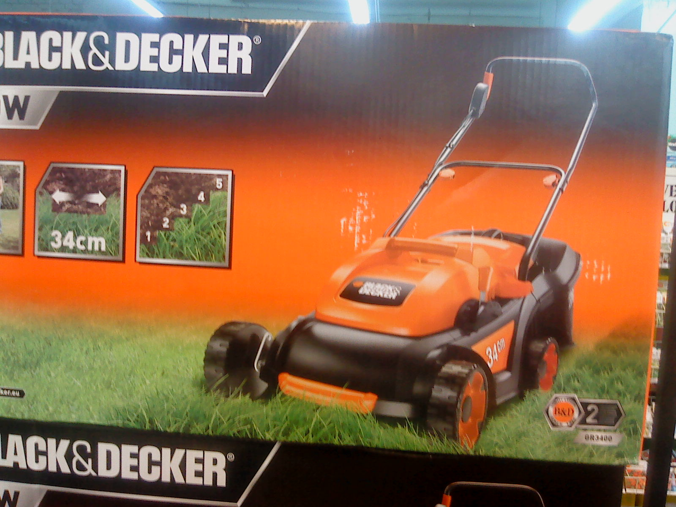

Why did we do this in-class activity?
People interpret things differently, how can you make things clear enough for everyone
Must give people more warnings than you initially think (Black & Decker, McDonalds coffee)
The words you use to describe something’s worth is crucial in marketing
Liability drives a lot of things in business

Slide 21
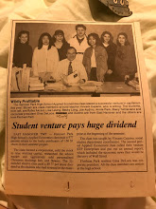
Who is this new teacher of yours?
21 years of experience in the corporate world before joining Tesla STEM
Resume in Canvas so that you know what background/experience of mine that you have at your disposal.
My high school entrepreneurship class with Mr. Capano
This class will be an amalgamation of:
My high school class that inspired me to go into business
Undergrad business classes
MBA program classes
Real-world experience consulting fed gov to tech to fortune 500 companies
Books read
Guest Speakers

Slide 22

Dual Credit
Earn 10 college credits if you get A or B in this class
$50 to register so you can have a transcript at Bellevue College
You transfer those credits to whatever college you’d like (mktg 101 and busm 101)
Saves you thousands of dollars in college
Link in syllabus and in Canvas announcements
Application not due until June; I’ll remind you before then

Slide 23
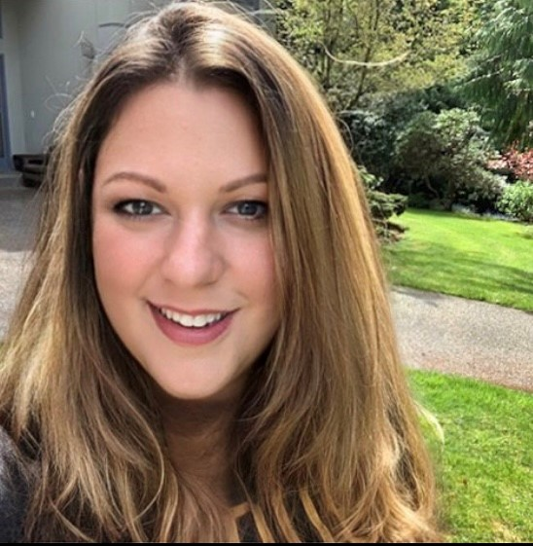
Assignment: Digital Reputation
Search for Ryfka Schafer on internet. What interesting clues can you find out about me that’s not on my resume?
Nothing to submit. However, please be prepared to talk about what you found next class.
Write 30 things down about me that you can find so you have something unique to share in class. We’ll go around the room, and you need to share something that others haven’t already shared.
I am NOT asking you to friend me or follow my social media. Please do not!
Be thinking about why I assigned this.

Slide 24
Digital Rep Results

Slide 25
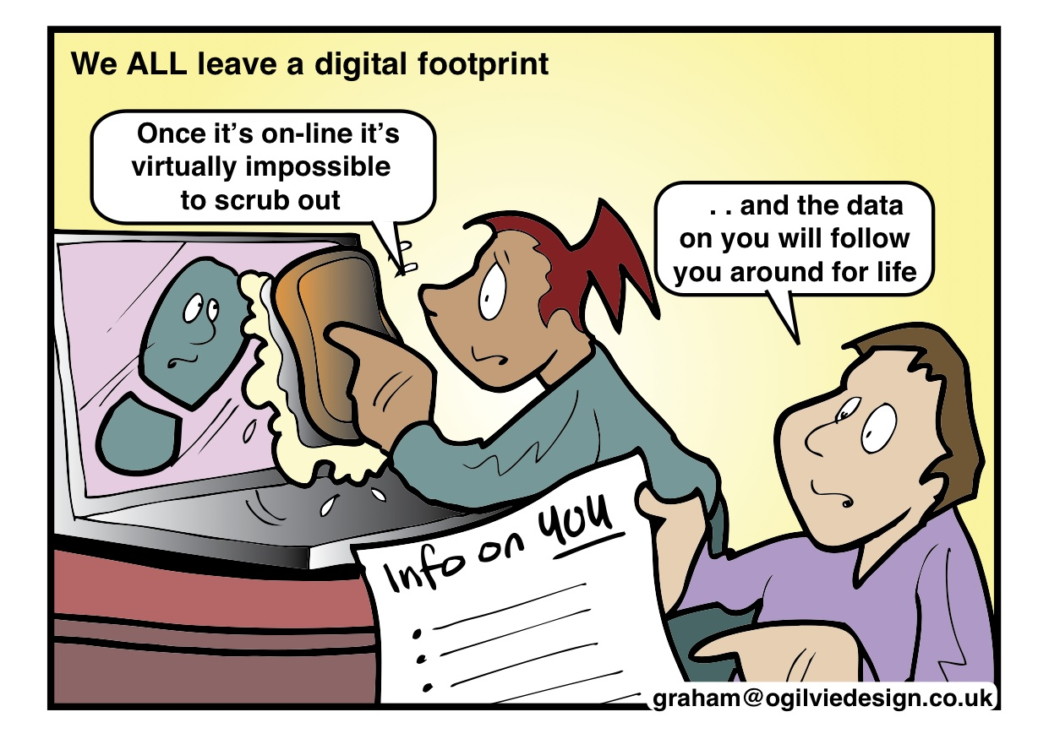
Digital Reputation
Why is it important to watch what you post online and to review what other people might have posted about you?
This Photo by Unknown Author is licensed under CC BY-SA-NC
Notes:
-employers look at this
-future spouses or friends may google you and make an impression of you before they even meet you
-stays with you forever
-hard to get rid of, stays with you forever
-want to hold a public office for the gov?
-There are big data algorithms that can connect your anonymous accounts to your real identity (simple searches can do this too—tell story of girl interviewing at Microsoft)
-privacy
-big data
-everything you do online is turned into a way to market to you, sell you things
-what can ppl piece together about you?
-safety (So excited to be going to India next week! – house vacant for a week/thieves see this)

Slide 26

Prugo also revealed that the first home burglary him and Lee participated in was at the home of an old friend of his named Eden Shizzle. Shizzle posted on MySpace that he was going on vacation with his family — and Prugo saw an easy target.
After their first burglary, Prugo got the idea to up the ante and burglarize celebrities next, so they started watching their social media accounts and gossip websites for info on when their houses would be vacant/they’d be on vacation.
While on celebrity gossip websites, Prugo says he saw that Paris Hilton was going to be in Miami and saw an opportunity.

Slide 27
Class Expectations (Contract)
Expectations
Revisit these throughout the year, as needed
My expectations of you
Your expectations of each other
Your expectations of ME! ☺

